Slide 1
Module 2 & 3 Class Problems

Slide 2
Q1. A Brayton cycle operates with isentropic compression and expansion, and air entering the compressor 27°C. The pressure ratio is 8:1, and the air leaves the combustion chamber at 1200 K. Compute a) the thermal efficiency of the cycle, b) temperature of air at the compressor outlet.

Slide 3
Q2. Suppose a power plant using the cycle in Q1 produces 700 million kWh/year of electricity. Ignore losses in the compressor and turbine. If the generator is 98% efficient and combustor is 88% efficient, and gas costs $10/GJ, calculate: a. The total gas energy content required per year b. The annual expenditure on gas c. The mass of CO2 emitted per year from the plant d. The mass of CO2 emitted per million kWh produced

Slide 4
Q3. A Brayton cycle operates with isentropic compression and expansion, and air entering the compressor 25°C. The pressure ratio is 10:1, and the air leaves the combustion chamber at 1000 K. air enters the compressor at atmospheric pressure of ~100 kPa at volumetric flow rate of 100 m³/s, Compute a) the thermal efficiency of the cycle, b) temperature of air at the compressor outlet, c) the net power produced by the power plant

Slide 5
Q4. Air enters the compressor of an air-standard Brayton cycle with a volumetric flow rate of 60 m³/s at 0.8 bar, 280 K. The compressor pressure ratio is 20, and the maximum cycle temperature is 2100 K. Assume both compressor and the turbine to be isentropic. Determine
the net power developed, in MW.
the rate of heat addition in the combustor, in MW.
the thermal efficiency of the cycle.

Slide 6
Q5. Air enters the compressor of an air-standard Brayton cycle with a volumetric flow rate of 60 m³/s at 80 kPa, 280 K. The compressor pressure ratio is 20, and the maximum cycle temperature is 2100 K. For the compressor, the isentropic efficiency is 92% and for the turbine the isentropic efficiency is 95%. Determine
the net power developed, in MW.
the rate of heat addition in the combustor, in MW.
the thermal efficiency of the cycle.
the rate of natural gas required to the combustor.
the rate annual CO₂ generation by the plant if the plant has an availability of 90% through the year

Slide 7
Q6. Compute the thermal efficiency of a Rankine cycle with isentropic compression and expansion for which steam leaves the boiler at 6 MPa and 480 C and is condensed at 50 kPa. Make appropriate assumptions if necessary.
Q7. Determine the mass flow rate of water through the boiler to produce 350 MW through the turbine.

Slide 8
Q8. Suppose a power plant using the cycle in Problems 6&7 produces 2.1 billion kWh/year of electricity. Ignore losses in the boiler and turbine. If the generator is 98% efficient and boiler is 84% efficient, and coal costs $30/tonne, calculate:
The total coal energy content required per year
The annual expenditure on coal
The mass of CO2 emitted per year from the plant
The mass of CO2 emitted per million kWh produce

Slide 9
Q9. Compute the work produced by the turbine, heat required by the boiler, mass flow rate of the steam through the boiler, and cycle efficiency if the following conditions are known about a simple Rankine cycle:
Turbine inlet temperature and pressures: 540 C and 5 MPa.
Turbine exhaust pressure of 12 kPa
Pump and turbine efficiency: 90, and 80% respectively
Net work produced by the plant: 180 MW

Slide 10
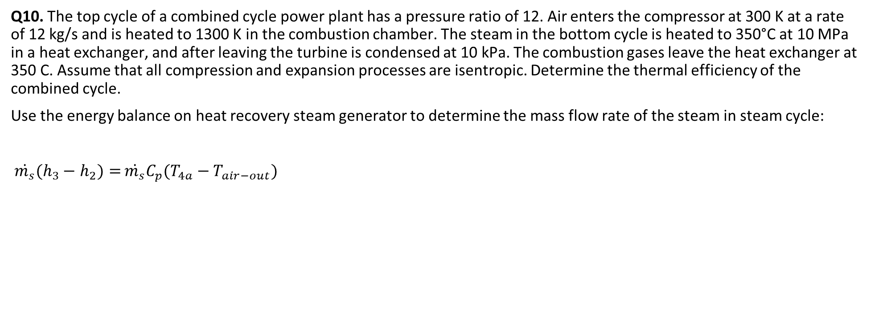
Combined Cycle
Q10. The top cycle of a combined cycle power plant has a pressure ratio of 12. Air enters the compressor at 300 K at a rate of 12 kg/s and is heated to 1300 K in the combustion chamber. The steam in the bottom cycle is heated to 350°C at 10 MPa in a heat exchanger, and after leaving the turbine is condensed at 10 kPa. The combustion gases leave the heat exchanger at 350 C. Assume that all compression and expansion processes are isentropic. Determine the thermal efficiency of the combined cycle.
Use the energy balance on heat recovery steam generator to determine the mass flow rate of the steam in steam cycle:
$\dot{m_{s}}(h_{3}−$ $h_{2})=$ $\dot{m_{s}}C_{p}(T_{4a}−T_{air−out})$

